Slide 1

Java Intro

Slide 2

What We’ll Cover Today
File Creation
The Main Method
Data Types
The System Class

Slide 3
What is Boilerplate Code?

Slide 4
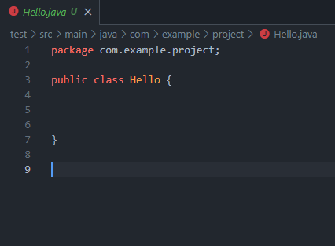
File Creation
Needs the Extension .java

Slide 5
File Creation
Needs the Extension .java
Depending on you editor and plugins may come with some boilerplate.

Slide 6
File Creation
Needs the Extension .java
Depending on you editor and plugins may come with some boilerplate.
Must have a public class with a name that matches the file.

Slide 7
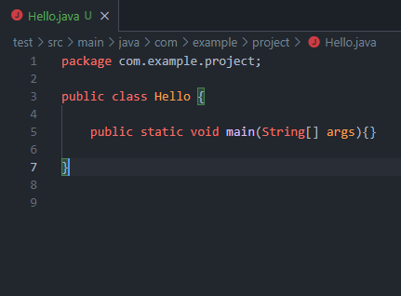
The Main Method
Named as such because of the name of the method.

Slide 8
The Main Method
Named as such because of the name of the method.

Slide 9
The Main Method
Named as such because of the name of the method.
Every program requires a main method.

Slide 10
The Main Method
Named as such because of the name of the method.
Every program requires a main method.
Also, a part of the java boilerplate.

Slide 11
The Main Method: Anatomy
public - access modifier

Slide 12
The Main Method: Anatomy
public - access modifier
static - non-access modifier

Slide 13
The Main Method: Anatomy
public - access modifier
static - non-access modifier
void - return type

Slide 14
The Main Method: Anatomy
public - access modifier
static - non-access modifier
void - return type
main - method name

Slide 15
The Main Method: Anatomy
public - access modifier
static - non-access modifier
void - return type
main - method name
String[ ] - the expected argument type

Slide 16
The Main Method: Anatomy
public - access modifier
static - non-access modifier
void - return type
main - method name
String[ ] - the expected argument
args - name of the argument

Slide 17
The Main Method: Anatomy
public - access modifier
static - non-access modifier
void - return type
main - method name
String[ ] - the expected argument
args - name of the argument

Slide 18
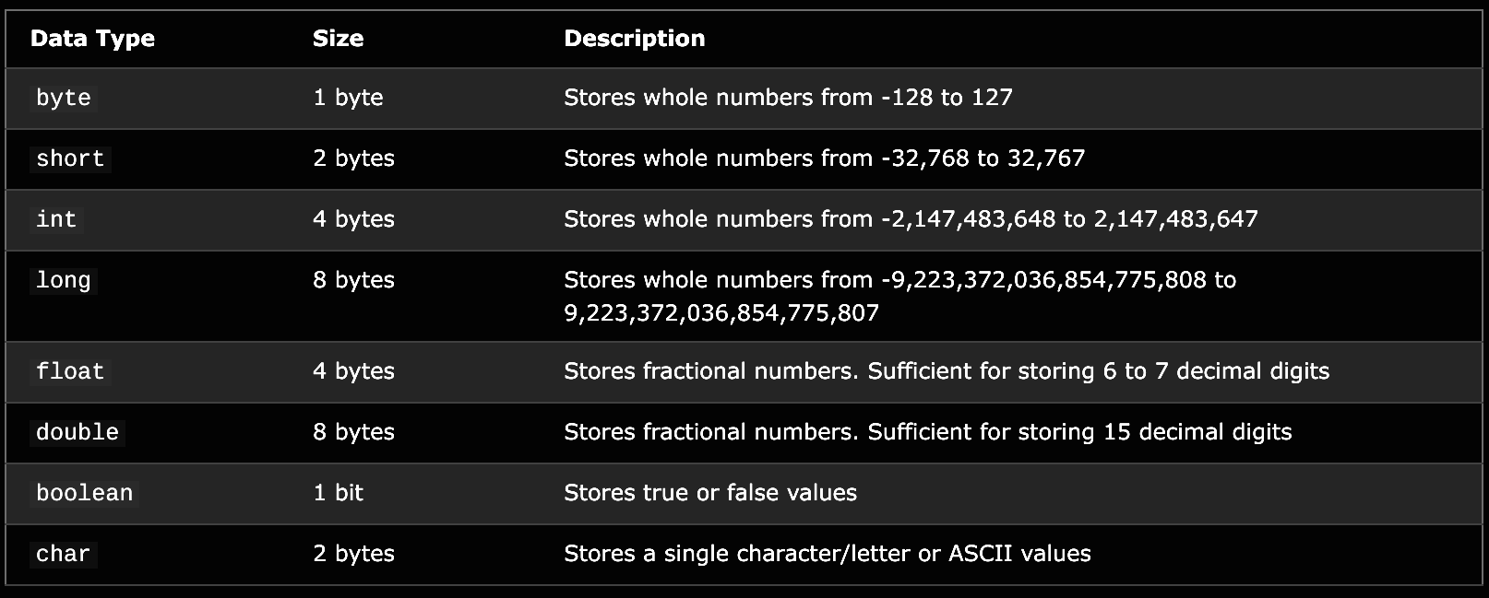
Primitive Data Types

Slide 19
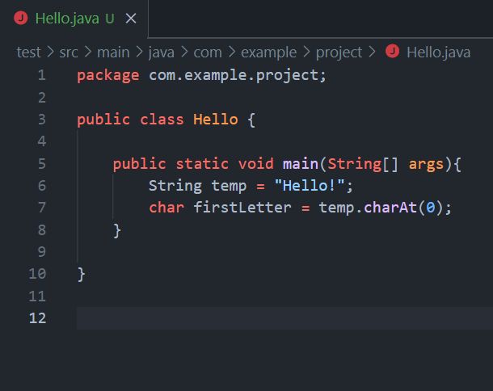
Non-Primitive Data Types
Strings - arrays of chars.

Slide 20
Non-Primitive Data Types
Strings - arrays of chars.
Or similar to that. Technically it is a custom data type that has all the functionality necessary to perform String operations

Slide 21
Non-Primitive Data Types
Strings - arrays of chars.
Or similar to that. Technically it is a custom data type that has all the functionality necessary to perform String operations
Arrays - arrays can be treated as a data type.

Slide 22
Non-Primitive Data Types
Strings - arrays of chars.
Or similar to that. Technically it is a custom data type that has all the functionality necessary to perform String operations
Arrays - arrays can be treated as a data type.
Classes / Custom Data Types - later in the class we will learn to create our own custom data types.

Slide 23
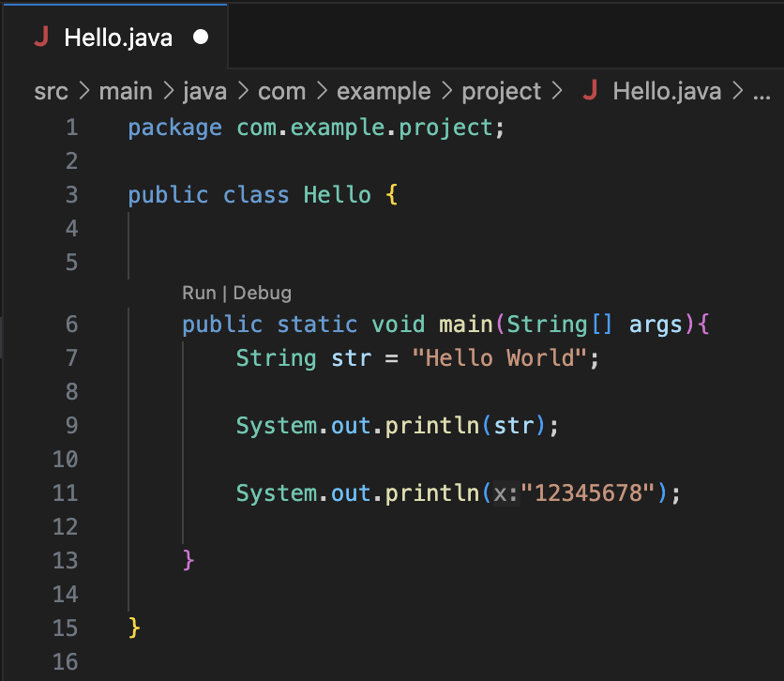
Data Type Literals
With each of these data types comes the ability to declare them literally in Java.
For Example:
“string” is a String literal
2 would be an int literal
2.0 would be a double literal
true would be a Boolean literal

Slide 24
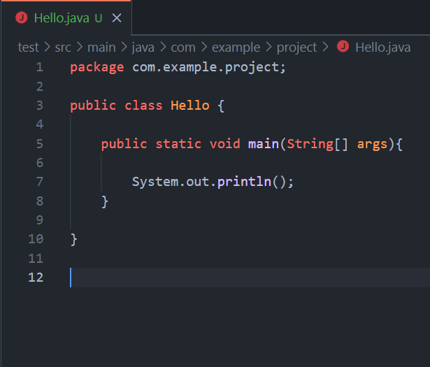
System Class
Among the facilities provided by the System class are standard input, standard output, and error output streams.

Slide 25
System Class
Among the facilities provided by the System class are standard input, standard output, and error output streams.
System.out - a subclass of System with many tools including print() and println().

Slide 26
System Class
Among the facilities provided by the System class are standard input, standard output, and error output streams.
System.out - a subclass of System with many tools including print() and println().
System.in - a subclass of System used to initiate Input Streams.

Slide 27
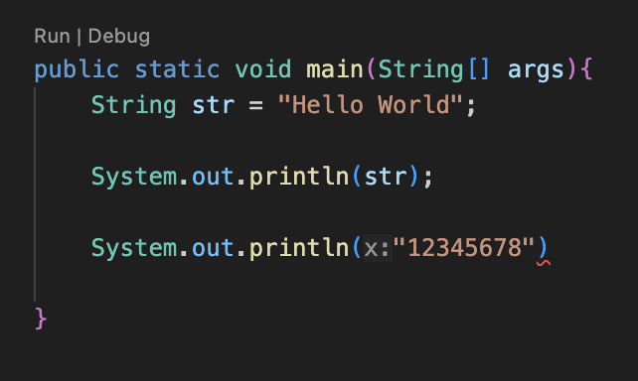
The Dreaded Semi-Colon
One final tricky part of Java is the fact that all non-structural lines of Java must contain a semi-colon at the end.
This is a large reason why I recommend an editor that is a little more developer friendly as it can point out these errors.

Slide 28

Let's hop in Live Share

Slide 29
For Today’s Lab
We won’t be using live share for our lab today but will instead be installing and validating tools.
There is a list of tools to install in the announcements on Moodle.
To validate that they are working:
Open the GUI based applications
In VSCode I would recommend installing the Extension Pack For Java inside the Extensions tab.
Enter “javac” into your terminal or powershell
Enter “git” into your terminal or powershell

Slide 30
Closing
Please Read: 1.1 Your First Java Program: Hello World
https://introcs.cs.princeton.edu/java/11hello/
And do Comprehension Assignment 1
Office Hours In SS-409:
Tu & Th 4:20pm – 5pm
Mon & Wed 1pm–4pm
Have a great first week and I’ll see you next Monday!

